Slide 1
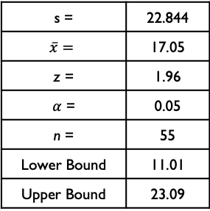
Process Improvement Project – Save $50 per Week
Process owner: Jason
Key Dates --->
Team Launch
January 11, 2019
Define
January 15, 2019
Measure
January 19, 2019
Analyze
February 2, 2019
Improve
February 11, 2019
Control
March 15, 2019
DEFINE
MEASURE
ANALYZE
IMPROVE
Problem Statement
Savings varies by week. Weekly average is $17.05 and the range of savings is $75.
s = | 22.844
$$\overline{x}=$$ | 17.05
z = | 1.96
$α$ = | 0.05
n = | 55
Lower Bound | 11.01
Upper Bound | 23.09
95% confidence interval that the true savings amount is between $11.01 and $23.09.
Business Impact
Increase savings to $2600 per year. This would be a 193% increase from my current savings of $886.60 per year.
Defects in the process are very common.
Current SQL = 0.4
Weekly savings vary and are consistently below the target amount of $50. The process is out of control.
Pareto shows that about 50% of my total spending falls into 3 categories.
The process is in control. There are spikes in the data every two weeks that go up to $100 or $50/week.
Improved SQL = 1.5
CONTROL
Transfer $100 to savings each pay period.
Keep the Way-To-Save checking account.
Cook more at home to limit the number of times ordering delivery or eating out to once a week.
Project Team: Jason Maloney

Slide 2
DEFINE
My goal is to save $50 per week, for an annual total of $2600. I will know I am successful if I have have saved $50 per week or have an average savings of $50 per week at the end of the month. The current steps in the process are as follows: Around the 15th of the month I pay my bills. If I deem that there is enough of the remaining money to put in savings, I transfer to my savings a varying amount every other week.
The variables that affect the goal are eating out or ordering delivery and the money spent, as defined as any meal not prepared at home, the money spent on entertainment, going out for activities, the money spent at the bar, the money spent on transportation (gas, MetroCard and tolls), and the money spent on bills, whether or not I drank alcohol that day, whether a day is during the week or weekend and whether or not I worked that day.
Success will be measured by whether or not I hit my goal of saving $50 per week or an average savings of $50 per week at the end of the month. The business impact would be to have more discretionary income and to eat at nicer restaurants for our date nights.

Slide 3
Measure: Data collection method
I have been tracking my savings on a spreadsheet over the course of 50 weeks before the class started. This was a result of total monthly savings divided by 4 to give an average weekly savings. I used my bank statement to get my total monthly savings.
To collect the other data, I looked at bank statements each Saturday and categorized the spending.
For weekend or weekday, I referred to a calendar. I needed to use my memory of the previous weekend to apply expenditures to weekends because my bank posts expenses on Monday.

Slide 4
MEASURE: Data Measurement Plan
Performance Measure | Data Source & Location | How will data be collected? | Who Will Collect Data | When Will Data Be Collected
Amount Saved (weeks 1 - 49) | Budget Spreadsheet | Averaged monthly savings to weekly (monthly savings/4) | Jason | Beginning of project
Amount Saved (weeks 50 - 59) | Bank account statements | From transfer information on bank statement | Jason | Each Saturday of the week
Weekday or weekend | Calendar | Cross reference calendar and bank statement | Jason | Each Saturday of the week
Did I work? | College Academic Calendar | Cross reference calendar and academic calendar | Jason | Each Saturday of the week
Eat out or Eat in | Bank account statements | From bank and credit card account statements | Jason | Each Saturday of the week
Drink Alcohol | manual data collection | From memory | Jason | Each Saturday of the week
Money Spent on Groceries | Bank account statements | From bank and credit card account statements | Jason | Each Saturday of the week
Money Spent on Transportation | Bank account statements | From bank and credit card account statements | Jason | Each Saturday of the week
Money Spent on Entertainment | Bank account statements | From bank and credit card account statements | Jason | Each Saturday of the week
Money Spent on Eat out or Delivery | Bank account statements | From bank and credit card account statements | Jason | Each Saturday of the week
Money Spent at the Bar | Bank account statements | From bank and credit card account statements | Jason | Each Saturday of the week
Money Spent on Bills | Bank account statements | From bank and credit card account statements | Jason | Each Saturday of the week
Money Spent on School | Bank account statements | From bank and credit card account statements | Jason | Each Saturday of the week
Money Spent on Pet | Bank account statements | From bank and credit card account statements | Jason | Each Saturday of the week
Money Spent on Clothes | Bank account statements | From bank and credit card account statements | Jason | Each Saturday of the week
Money Spent on Alcohol | Bank account statements | From bank and credit card account statements | Jason | Each Saturday of the week

Slide 5
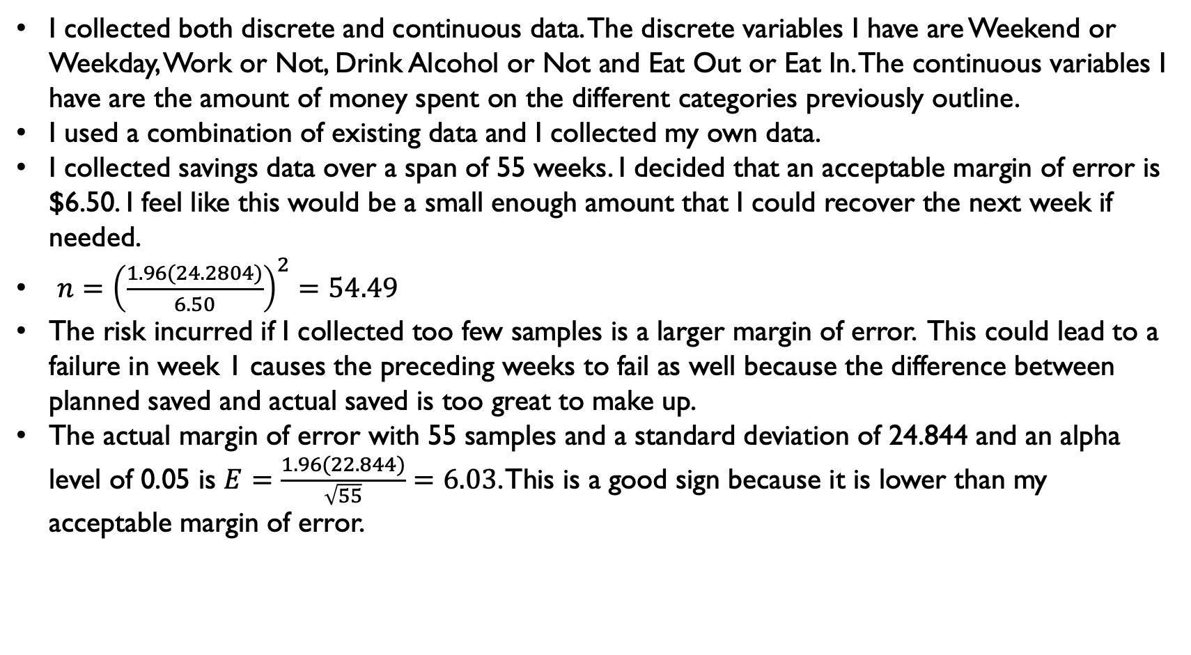
MEASURE: Variables and Sample Size
I collected both discrete and continuous data. The discrete variables I have are Weekend or Weekday, Work or Not, Drink Alcohol or Not and Eat Out or Eat In. The continuous variables I have are the amount of money spent on the different categories previously outline.
I used a combination of existing data and I collected my own data.
I collected savings data over a span of 55 weeks. I decided that an acceptable margin of error is $6.50. I feel like this would be a small enough amount that I could recover the next week if needed.
$n={\left(\frac{1.96(24.2804)}{6.50}\right)}^{2}=54.49$
The risk incurred if I collected too few samples is a larger margin of error. This could lead to a failure in week 1 causes the preceding weeks to fail as well because the difference between planned saved and actual saved is too great to make up.
The actual margin of error with 55 samples and a standard deviation of 24.844 and an alpha level of 0.05 is $E=\frac{1.96(22.844)}{\sqrt{55}}=6.03$. This is a good sign because it is lower than my acceptable margin of error.

Slide 6
MEASURE: Measurement Error
I can have measurement error in determining which days I spent money on different variables. The bank statements post each Monday, so any expenditures from Friday – Sunday all have the same date. I used my memory of the weekend’s activities to determine whether money was spent during the week or on the weekend. One way to reduce this is to track spending in real time manually or with an application on my phone.

Slide 7
ANALYZE: SQL
Calculate SQL | Value
Opportunities for Defects = | 1
Total Number of Weeks = | 55
Total Possible Defects = | 55
Actual Defects = | 47
Defects Per Opportunity = | 0.854545
Defects Per Opportunity Percent | 85.454545%
Defects Per Million Opportunities = | 854545.4545
SQL = | 0.4
As we can see, my old process is severely broken and has a lot of room for improvement. I have been missing my savings goal 86% of the time, which gives a yield of successful weekly savings of only 14%. This is shown in the line graph above. There are clear spikes in time when I do meet my goal and there are spikes below the goal, which provide further evidence of a broken process. There is a lot of randomness in the amount saved per week.

Slide 8
ANALYZE : Pareto Chart
I first looked at what I am spending the majority of my money on to try to save more by spending less. I see that of my expenditures, eating out at restaurants or ordering delivery and entertainment make the majority at nearly 20% combined. I had a hunch that this would be the case. Coming in next is money spent on transportation. I can adjust and improve the amount spent on entertainment and eating out or ordering delivery, but I am unwilling to change my transportation habits.

Slide 9
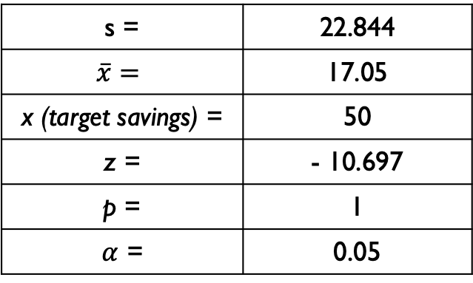
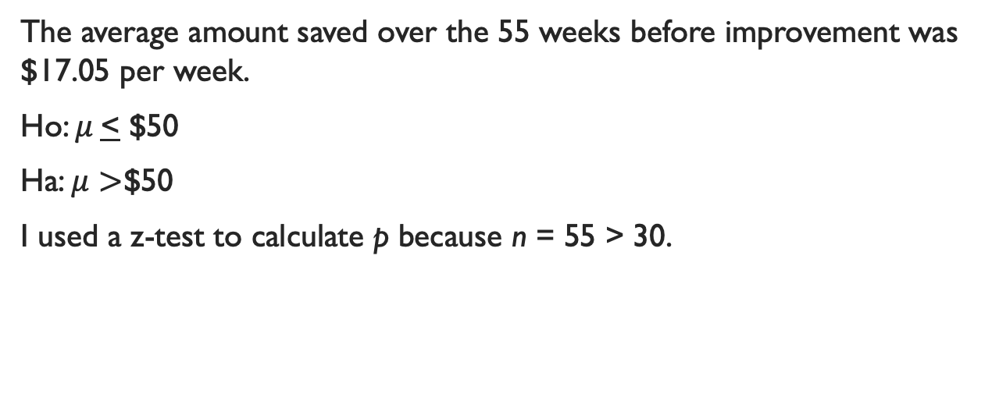
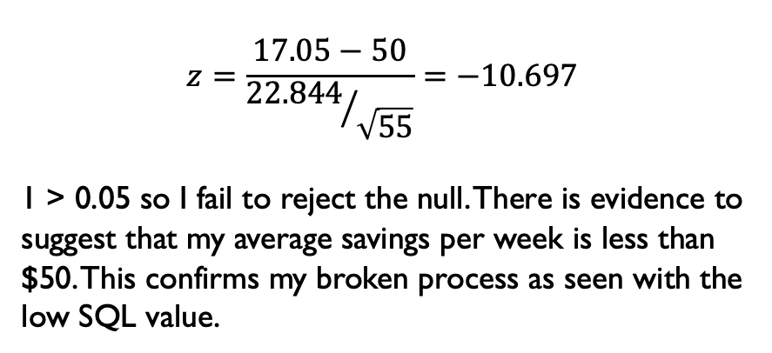
ANALYZE: Right Tailed Hypothesis Test of Amount Saved
The average amount saved over the 55 weeks before improvement was $17.05 per week.
Ho: $μ$< $50
Ha: $μ>$$50
I used a z-test to calculate p because n = 55 > 30.
s = | 22.844
$$\overline{x}=$$ | 17.05
x (target savings) = | 50
z = | - 10.697
p = | 1
$α$ = | 0.05
$$z=\frac{17.05−50}{{22.844}/{\sqrt{55}}}=−10.697$$
1 > 0.05 so I fail to reject the null. There is evidence to suggest that my average savings per week is less than $50. This confirms my broken process as seen with the low SQL value.

Slide 10
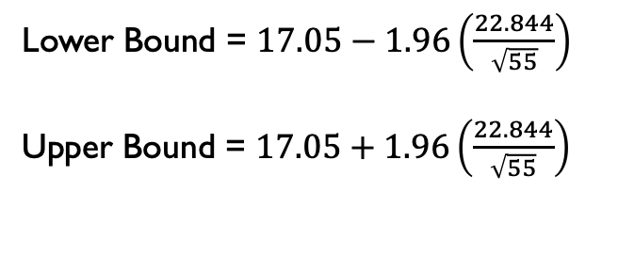
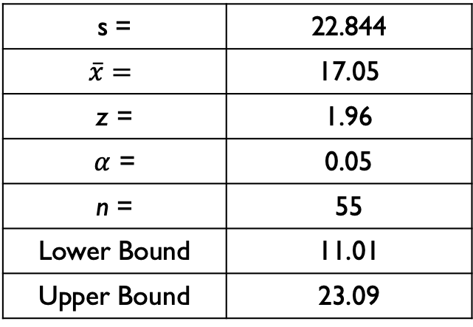
ANALYZE: Confidence Interval of Amount Saved
Lower Bound = $17.05−1.96\left(\frac{22.844}{\sqrt{55}}\right)$
Upper Bound = $17.05+1.96\left(\frac{22.844}{\sqrt{55}}\right)$
s = | 22.844
$$\overline{x}=$$ | 17.05
z = | 1.96
$α$ = | 0.05
n = | 55
Lower Bound | 11.01
Upper Bound | 23.09
If I were to perform this analysis over several different 55 week time spans, 95% of the time my actual savings per week would be between $11.01 and $23.09. There is a lot of room for improvement to hit my goal of $50 per week.

Slide 11
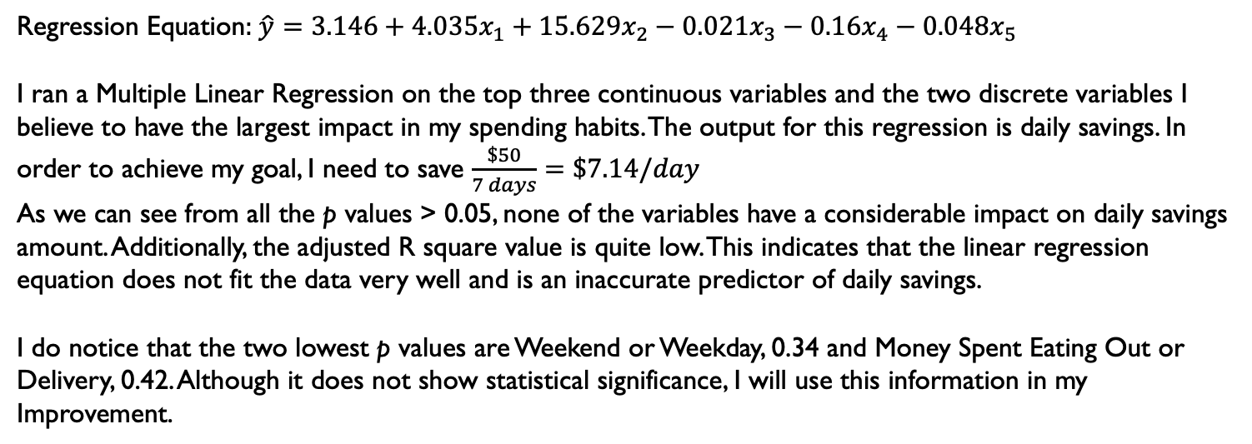
ANALYZE: Multiple Linear Regression
Variable | Variable Name | Coefficients | P-value
 | Intercept | 3.14584115 | 0.424851
 | Drink Alcohol (1 = Yes, 0 = No) | 4.035857044 | 0.817758
 | Weekend (1) or Weekday (0) | 15.62851047 | 0.347882
 | Money Spent on Entertainment | -0.02144093 | 0.919291
 | Money Spent on Eating Out or Delivery | -0.16012705 | 0.426671
 | Money Spent on Transportation | -0.0476811 | 0.434179
Regression Statistics
Multiple R | 0.545866232
R Square | 0.297969943
Adjusted R Square | 0.130819929
Regression Equation: $\hat{y}=3.146+4.035x_{1}+15.629x_{2}−0.021x_{3}−0.16x_{4}−0.048x_{5}$
I ran a Multiple Linear Regression on the top three continuous variables and the two discrete variables I believe to have the largest impact in my spending habits. The output for this regression is daily savings. In order to achieve my goal, I need to save $\frac{\$50}{7 days}=\$7.14/day$
As we can see from all the p values > 0.05, none of the variables have a considerable impact on daily savings amount. Additionally, the adjusted R square value is quite low. This indicates that the linear regression equation does not fit the data very well and is an inaccurate predictor of daily savings.
I do notice that the two lowest p values are Weekend or Weekday, 0.34 and Money Spent Eating Out or Delivery, 0.42. Although it does not show statistical significance, I will use this information in my Improvement.

Slide 12
ANALYZE: Control Charts
The control charts for both the moving range and x bar show that the process is out of control. There is no order or reason for the weekly savings amounts before the improvement. At this point, I do not have one or two specific reasons for the process being out of control. It appears that I need to try to cut spending in a variety of categories, especially on the weekend.

Slide 13
IMPROVE
The improvements I made to my process are as follows:
I changed my checking account to a Way-to-Save account that transfers
$1 - $4 each time I use my debit card. The amount transferred is dependent upon the amount spent. This can help me begin to save during the week without explicitly transferring money to my savings account.
I created the process of transferring $100 to my savings account each biweekly pay period. This will average $50 savings per week.
My wife and I have made a concerted effort to only go to dinner or order take out once a week.

Slide 14
IMPROVED SQL
My SQL improved from 0.4 to 1.5. There is still much improvement to be made. Looking at the total saved per week graph below, we can see that after the improvement in week 55, the savings amount has a pattern and is consistently above 0. This is a huge improvement from the random spikes and plateaus seen in the first 54 weeks of data.
Calculate SQL
Opportunities for Defects = | 1
Total Number of Weeks = | 6
Total Possible Defects = | 6
Actual Defects = | 3
Defects Per Opportunity = | 0.5
Defects Per Opportunity Percent | 50
Defects Per Million Opportunities = | 500000
SQL | 1.5

Slide 15

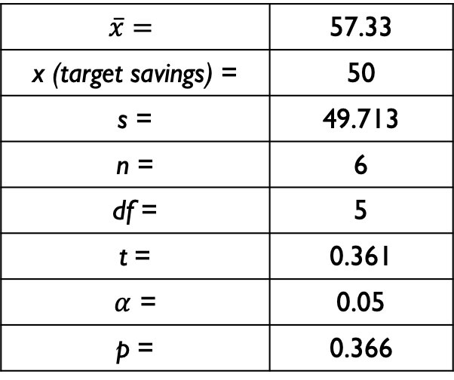
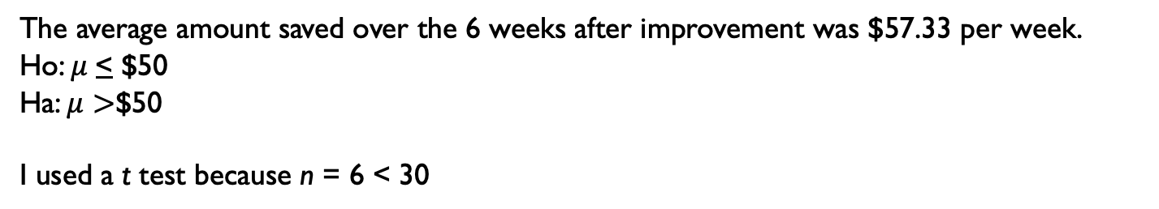
IMPROVE: Right Tailed Hypothesis Test of Amount Saved
The average amount saved over the 6 weeks after improvement was $57.33 per week.
Ho: $μ$< $50
Ha: $μ>$$50
I used a t test because n = 6 < 30
$$t=\frac{57.33−50}{{49.713}/{\sqrt{6}}}=0.361$$
$$\overline{x}=$$ | 57.33
x (target savings) = | 50
s = | 49.713
n = | 6
df = | 5
t = | 0.361
$α$ = | 0.05
p = | 0.366
0.366 > 0.05 so I fail to reject the null. There is evidence to suggest that my average savings per week is less than $50. This is a better p value than I found before the improvement, so the result is promising, even though I still have a ways to go. This is echoed in my improved SQL score of 1.5 from 0.4.

Slide 16
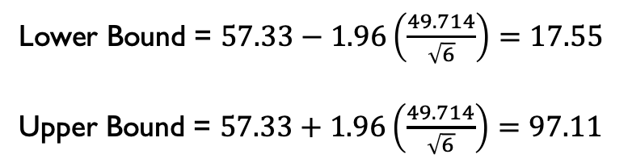
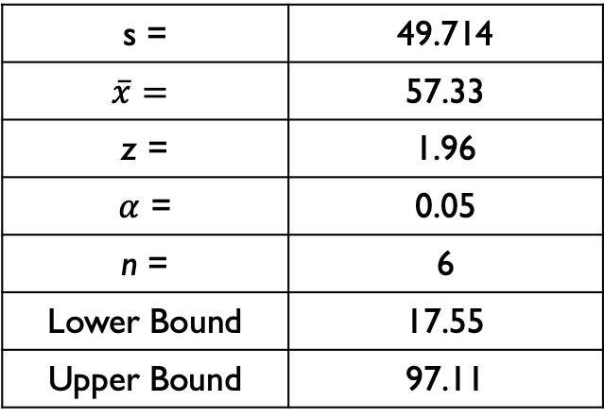
IMPROVE: Confidence Interval of Amount Saved
Lower Bound = $57.33−1.96\left(\frac{49.714}{\sqrt{6}}\right)=17.55$
Upper Bound = $57.33+1.96\left(\frac{49.714}{\sqrt{6}}\right)=97.11$
s = | 49.714
$$\overline{x}=$$ | 57.33
z = | 1.96
$α$ = | 0.05
n = | 6
Lower Bound | 17.55
Upper Bound | 97.11
If I were to perform this analysis over several different 6 week time spans, 95% of the time my actual savings per week would be between $17.55 and $97.11. My target goal is well within the confidence interval which is a vast improvement from the start of the project.

Slide 17
IMPROVE: Results
After implementing the improvements, the process is in control. There are no trends and both the moving range and the weekly savings amount are within the upper and lower control limits.
The line graph below shows the weekly savings amounts. There are the spikes we would expect to see based on the biweekly transfers. In addition, I should not have any more weeks of saving $0 because of my new checking account.

Slide 18
CONTROL
I have improved my process using my defined measure of success. I am now averaging a savings of $50 per week.
In order to continue meeting my goal, I will use this information to persist with my savings process of immediately transferring $100 to my savings account on payday. I also will keep my new checking account to assist in small daily transfers that go unnoticed.
My wife and I are trying to buy more versatile groceries and cook at home. I feel that this is an area where we have the control to curtail excessive spending and plan date nights thoughtfully and within our budget.

